Slide 1
Symphony of Words
Autonomous Poetry Generation System
2nd presentation
Maria-Daria Tompea

Slide 2
agenda
The contents of this presentation
01 Introduction and Research Challenge
02 Dual-Engine Methodology and Architecture
03 Core Generation Engines
04 Bidirectional and Advanced Generation Strategies
05 System Architecture and Implementation
06 Expected Results, Benchmarks, and Conclusion

Slide 3
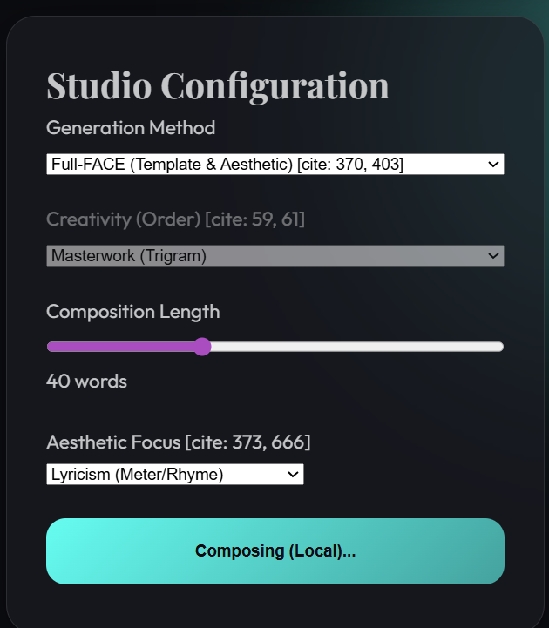
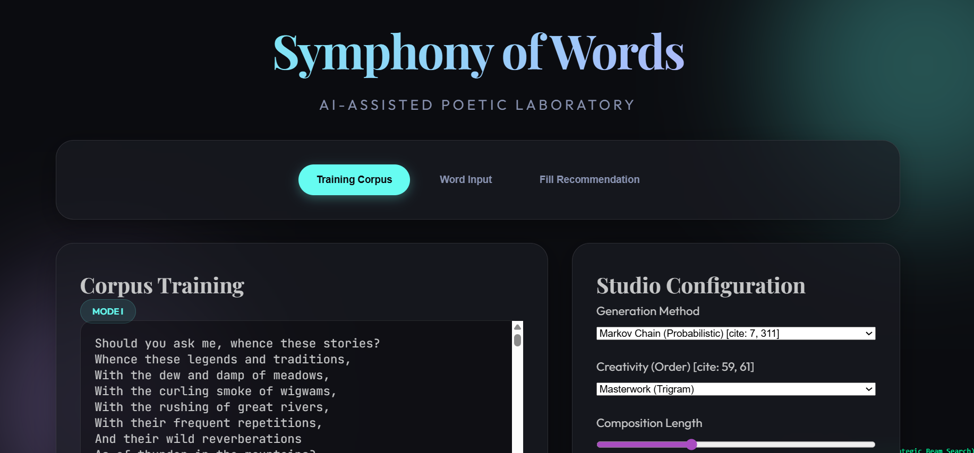
CORE IDEA
Symphony of Words is an advanced autonomous poetry
generation system.
The project addresses the intersection of artificial intelligence
and creative writing by designing a dual-engine methodology
capable of generating coherent, semantically meaningful
poetic compositions across multiple languages and stylistic
parameters.

Slide 4
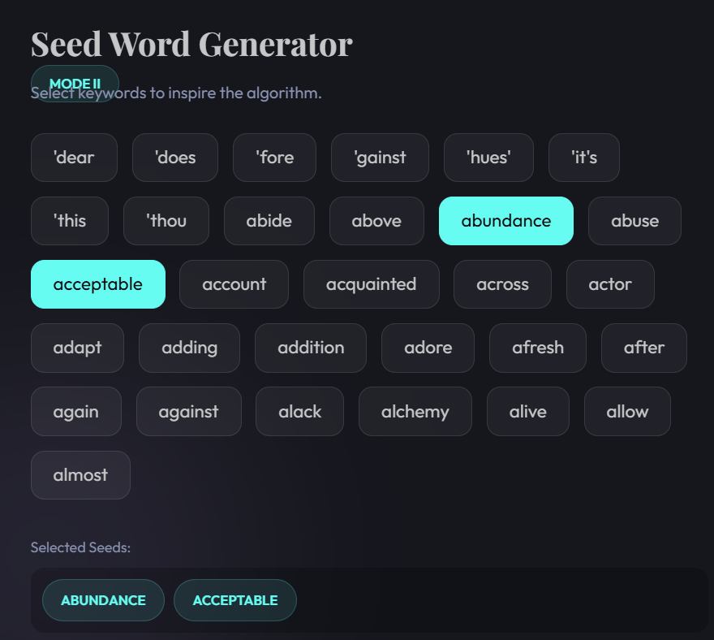
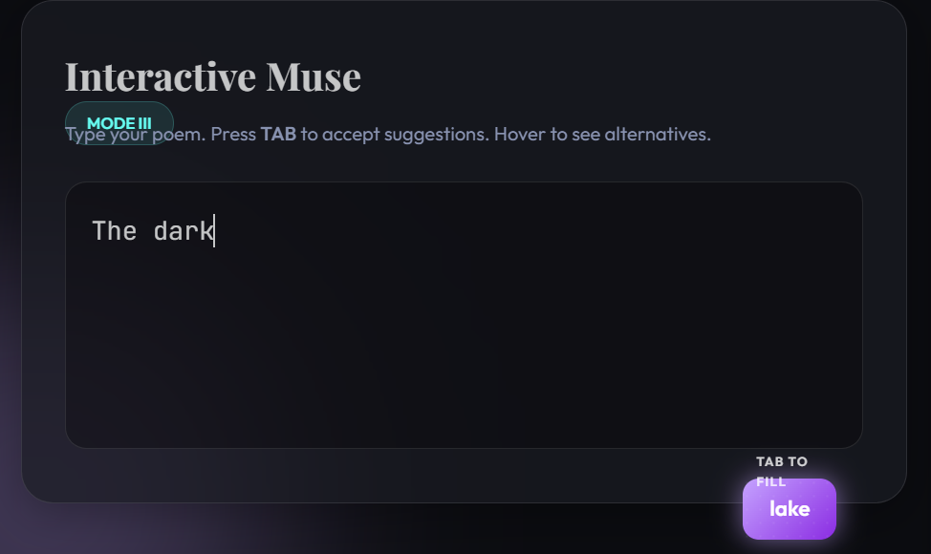

Slide 5
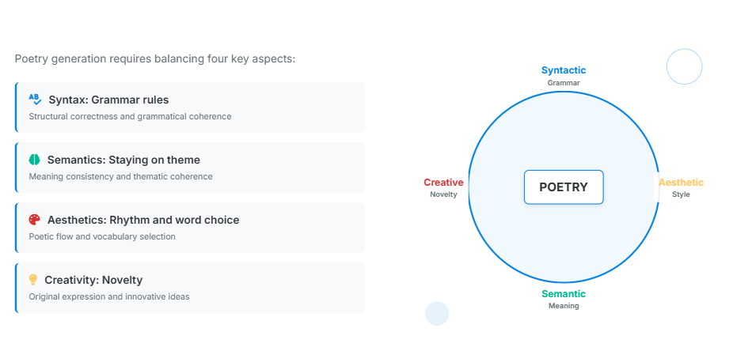
4 rules
must follow grammar rules
Find a middle ground of all
the four aspects
The machine has to find a common point to satisfy
all the four rules:
-Syntax : following specific grammar rules of a language
-Semantic : find words related to the same topic
-Aesthetics : rhythm , rhyme , poetic words
-Creativity : should create something new
All while making the poem feel “right”.
should follow a specific topic

Slide 6
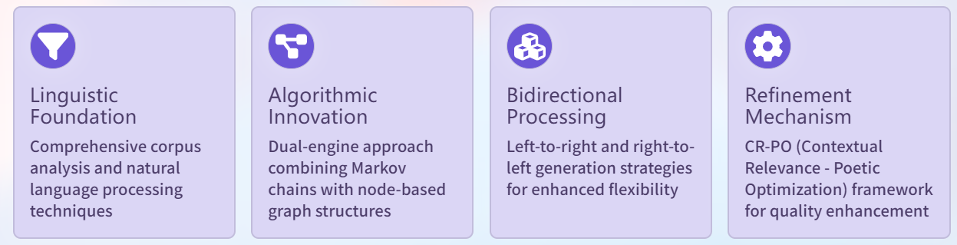
The four core pillars
First, we teach the AI the rules of language by letting it study thousands of classic poems.
We use two different coding methods together to make the generation both very fast and logically smart.
The AI can write verses in both directions, which helps it plan the perfect rhyme at the end of each line.
We also included a "refinement" step that replaces boring, common words with more colorful and poetic ones.

Slide 7
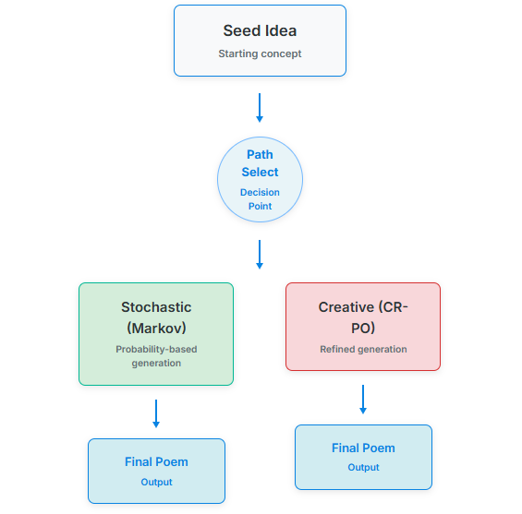
Methodology: Dual-Engine Approach
Fast, statistical coherence vs. Enhanced poetic quality
The process starts with a Seed Idea, where you type in a simple word or a starting concept.
Next, the system reaches a Decision Point to choose the best way to write your poem.
One way is the Markov Path, which uses math and probability to pick words that fit together.
The other way is the Creative Path, which is a more advanced method focused on artistic quality.
Both methods work hard to make sure the lines of the poem sound natural and beautiful.
Finally, the system delivers the Final Poem as the completed result of the generation.

Slide 8

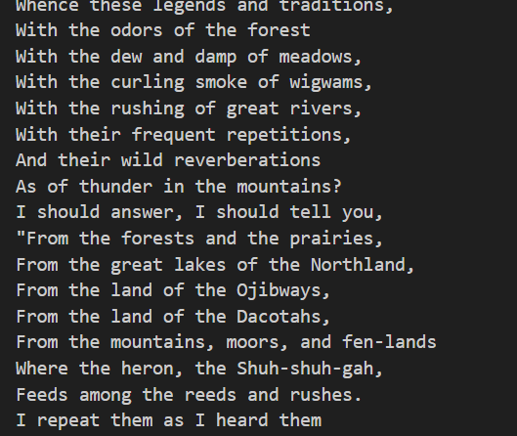
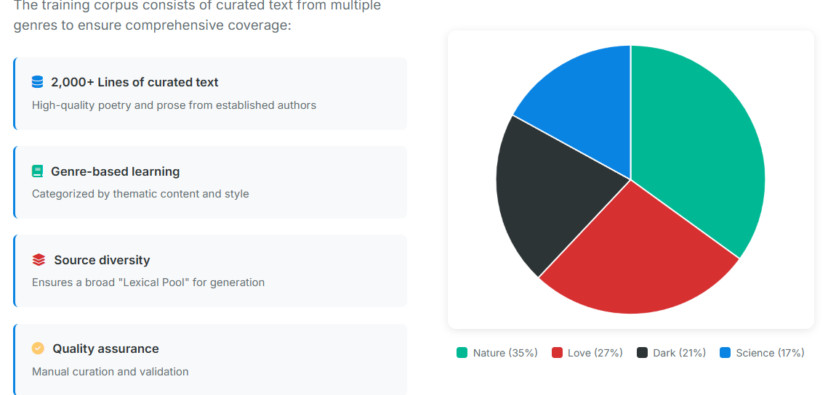
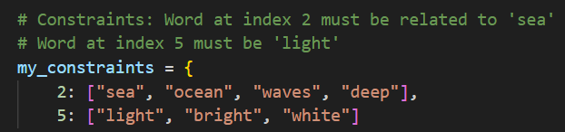
Training Corpus and Dataset Construction
Main.py

Slide 9
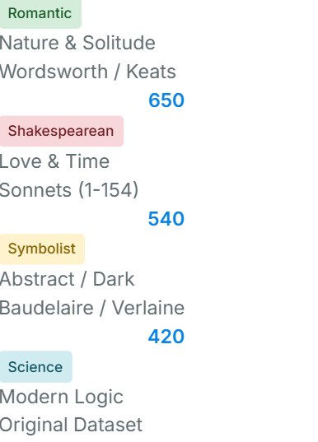
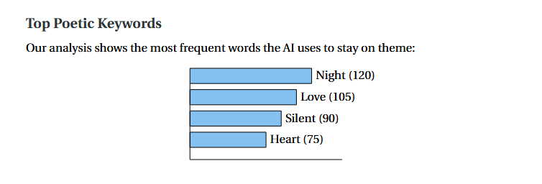
Statistics:used data

Slide 10
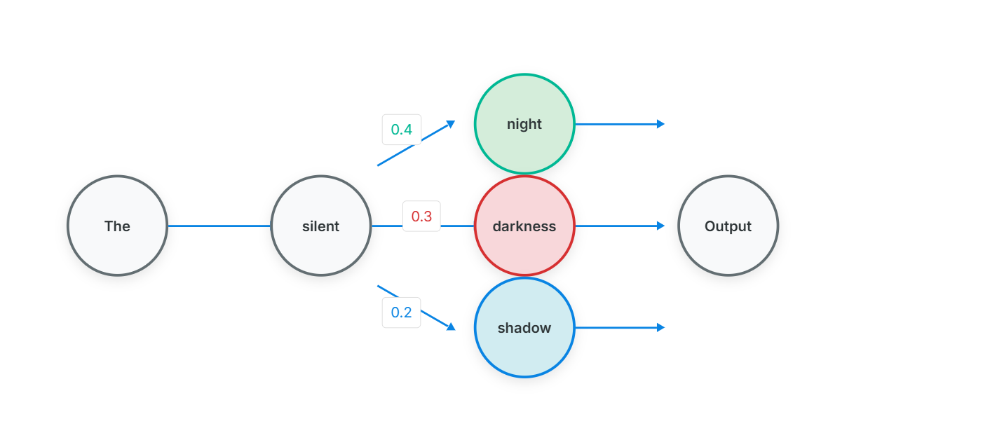
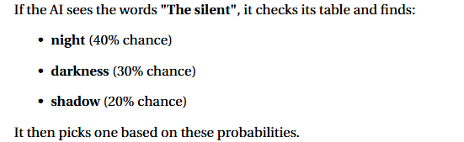
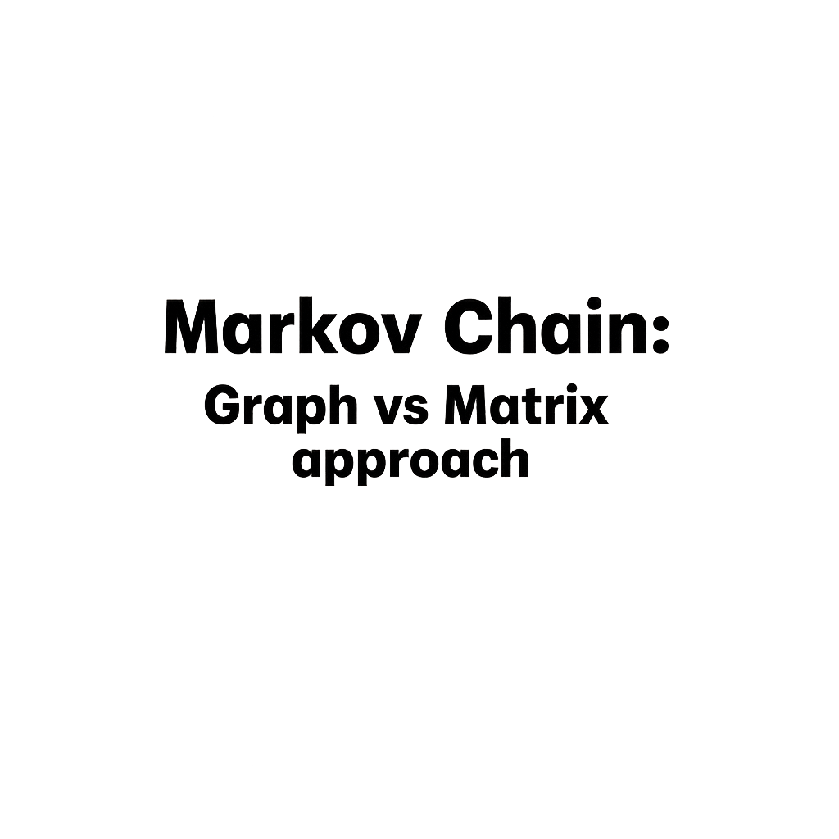
MARKOV CHAIN
The Markov Chain engine operates on statistical probability distributions
derived from the training corpus. Each word token is associated with conditional
probabilities based on preceding words, enabling sequential generation that
maintains local linguistic coherence and natural language flow patterns typical
of poetic structures.

Slide 11
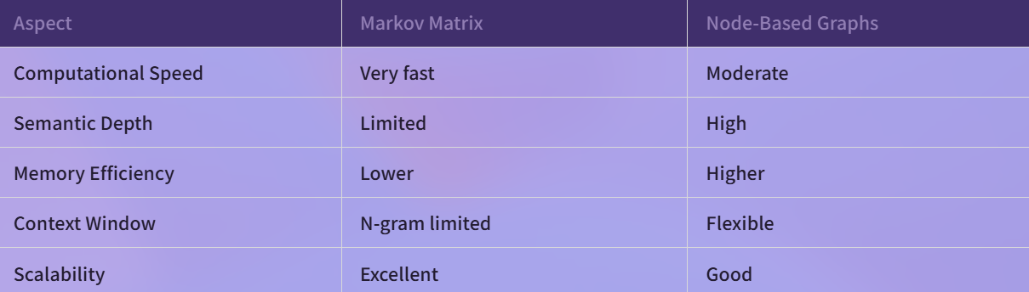
COmparison
This comparison highlights the essential trade-off between computational speed and the overall quality of the poetry.
A 2nd degree n-gram using a matrix is extremely fast because the system only needs to perform a simple table lookup for word pairs.
However, this method has limited semantic depth because the model can only "remember" one word back, often losing the topic of the poem.
On the other hand, a 3rd or 4th degree n-gram using a node-based graph provides much higher context and artistic flow.
While matrices become too large and inefficient at higher
degrees, graphs are better for memory because they only store
connections that actually appear in the text.
Ultimately, matrices are excellent for basic scalability, while
node-based graphs are superior for creating deep and
meaningful verses.

Slide 12
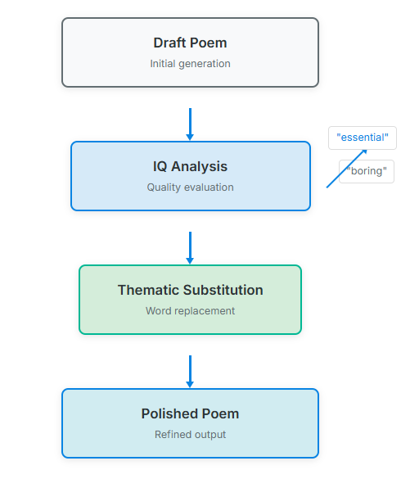
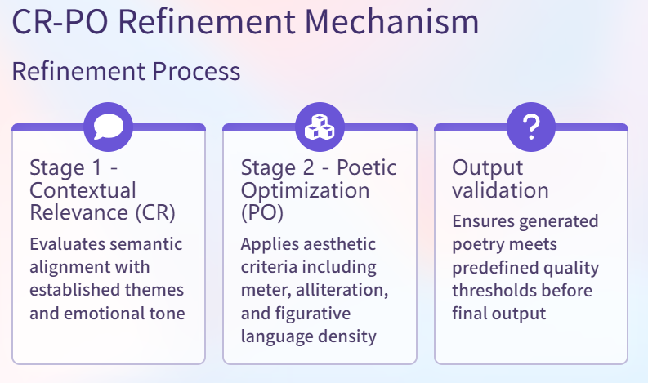
CR-PO Refinement
IQ Analysis: Evaluates poem quality and identifies areas for improvement
Thematic Substitution: Replaces low-quality words with better alternatives
Final Polishing: Produces refined, high-quality output

Slide 13
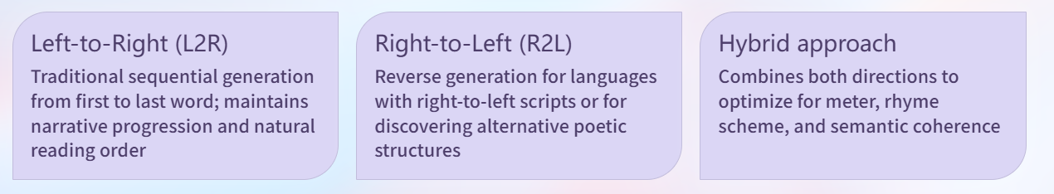
A.Rhyme

Slide 14
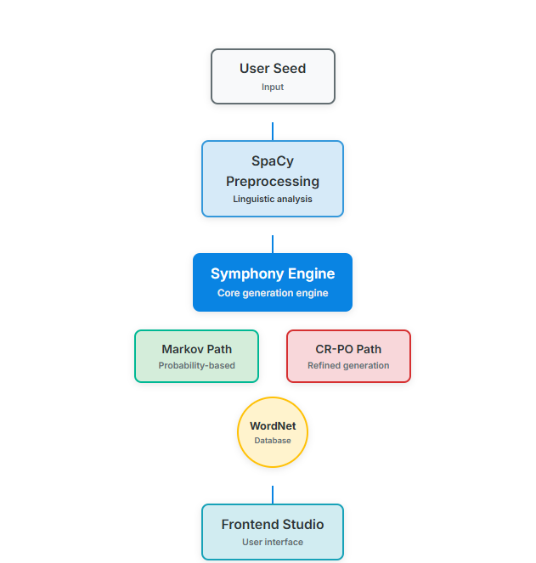
Full Application Architecture
The architecture is a structured pipeline that begins when the user provides a seed word and selects specific generation parameters.
This input is handled by a linguistic preprocessing layer using SpaCy to analyze the grammatical context and parts of speech.
The core logic then passes through the Symphony Engine, which utilizes a hybrid approach of stochastic Markov chains and creative CR-PO refinement supported by the WordNet database.
Finally, the results are sent to the Frontend Studio, where the generated poem is displayed to the user in a clean and interactive interface.

Slide 15
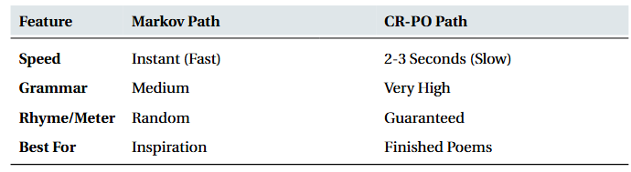
RESULTS
Came the warriors from the west, (A)
Putting courage to the test. (A)
Bury now your heavy spear, (B)
For the time of peace is near. (B)
From the footprints flowed a tide, (C)
Where the ancient spirits hide. (C)
I have given you lands to see, (A)
Where the spirit wanders free. (A)
Bathe now in the rushing stream, (B)
Like the patterns of a dream. (B)
Wash the paint from every face, (C)
Of this brave and ancient race. (C)

Slide 16
Thank you

